Slide 1


CompSci club
Introduction to Loops
Stop rewriting code! Introducing, loops!

Slide 2

Our person of the day!
Mark surman
Surman currently heads the Mozilla Foundation, a non-profit organization that “[is] dedicated to preserving choice and promoting innovation on the Internet.”
On November 9, 2004, Mozilla 1.0 was released, and Firefox has had a monumental effect on the internet as when it was released, Microsoft’s Internet Explorer controlled over 90% of the browser marketplace for many years
Though Firefox is not the most dominant browser right now (Chrome has that title), estimates put its current usage at 4 to 5%
From a CS standpoint, this is an incredible achievement given that all of Mozilla’s source code is open-source and available for the public
Partaking in open-source projects is an incredible way to make a difference in a huge or small projects!
Executive Director of the Mozilla Foundation

Slide 3
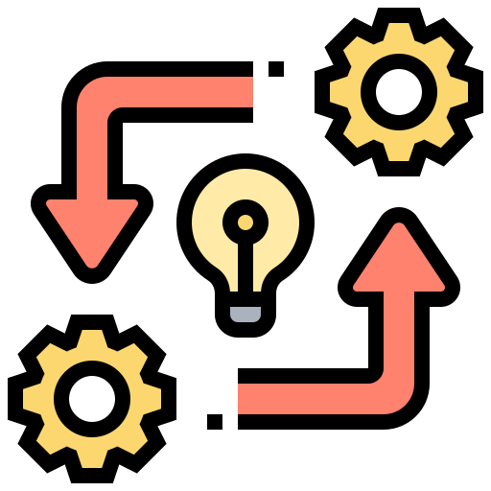
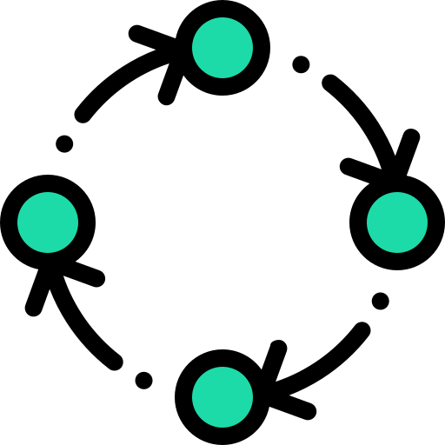

Roadmap for Today
An overview of loop logic
Loops will help us repeat tasks over and over again without copy and paste!
Loop Syntax
Loops look a bit different in every language, but they are quite simple in Python!
Practice with Loops
Not a lot of practice today — that will be the focus of next week’s lesson!

Slide 4
Alas, you do not need to print out 17 print statements!
A introduction to
Loop Logic

Slide 5
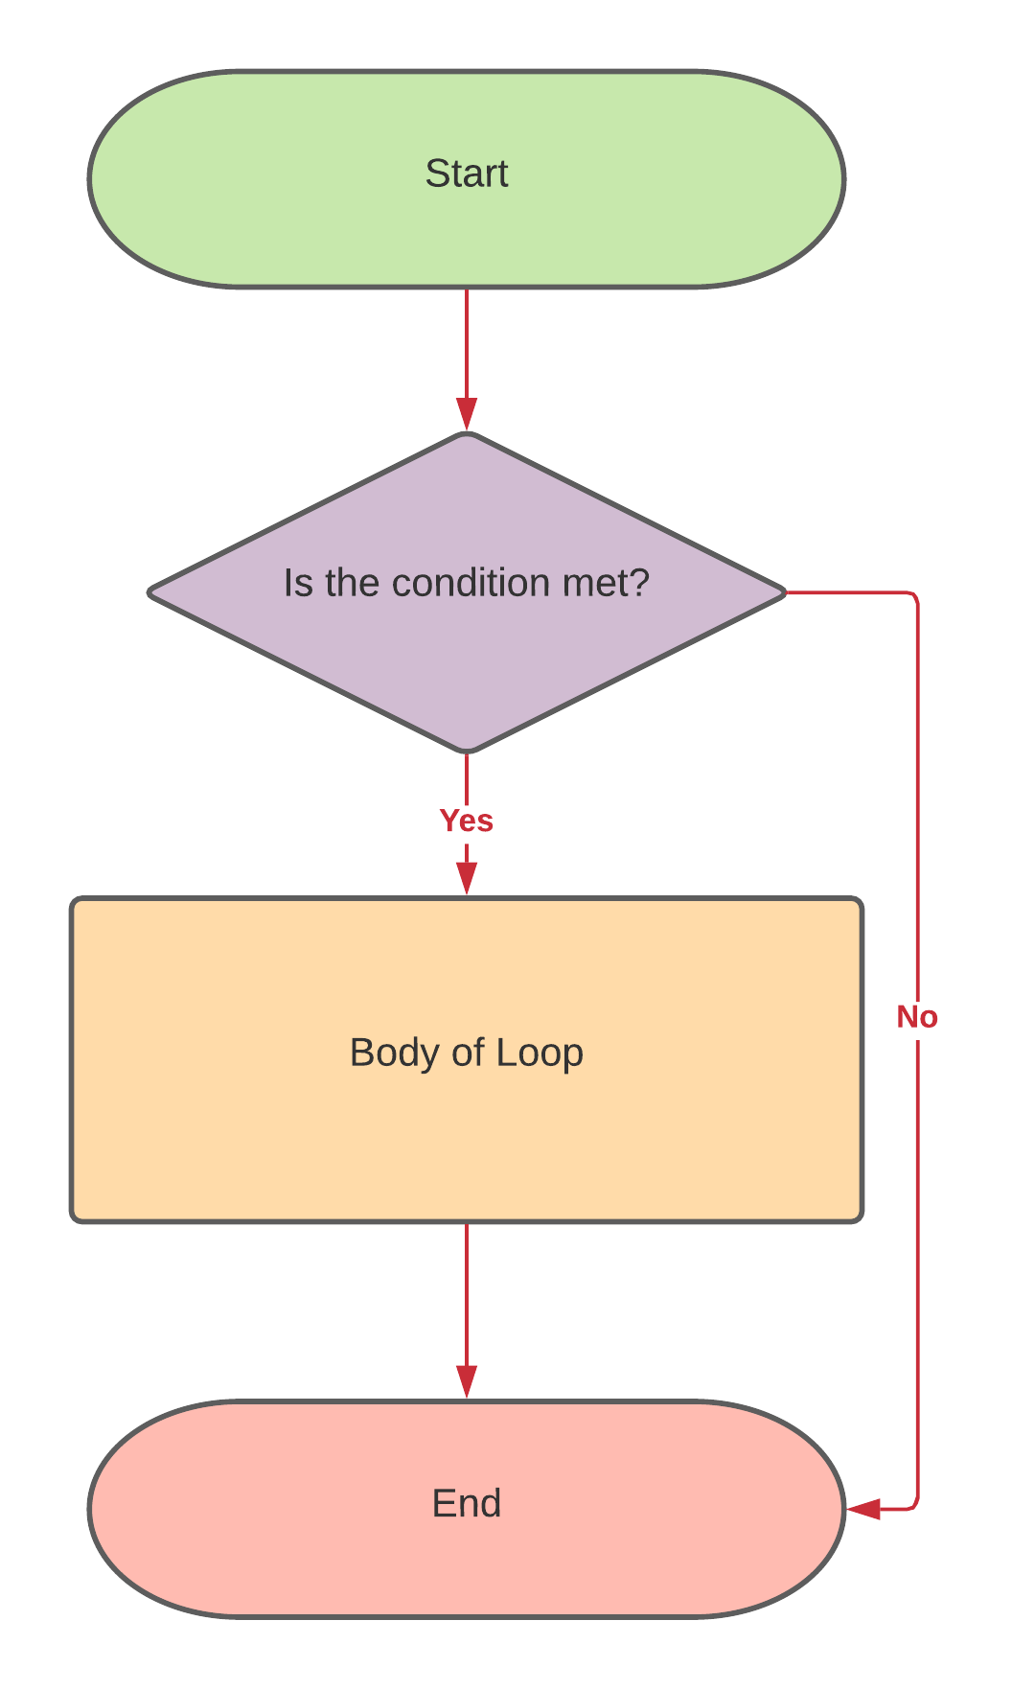
What are Loops?
As the name suggests, loops are tools in programming that allow us to loop over blocks of code
There are a few types of loops, such as for loops, do-while loops, and while loops
All of these differ in the amount of times they loop
The main point of loops is to remember that they will loop only while a condition is true, and allow us to execute massive swaths of code at once!

Slide 6
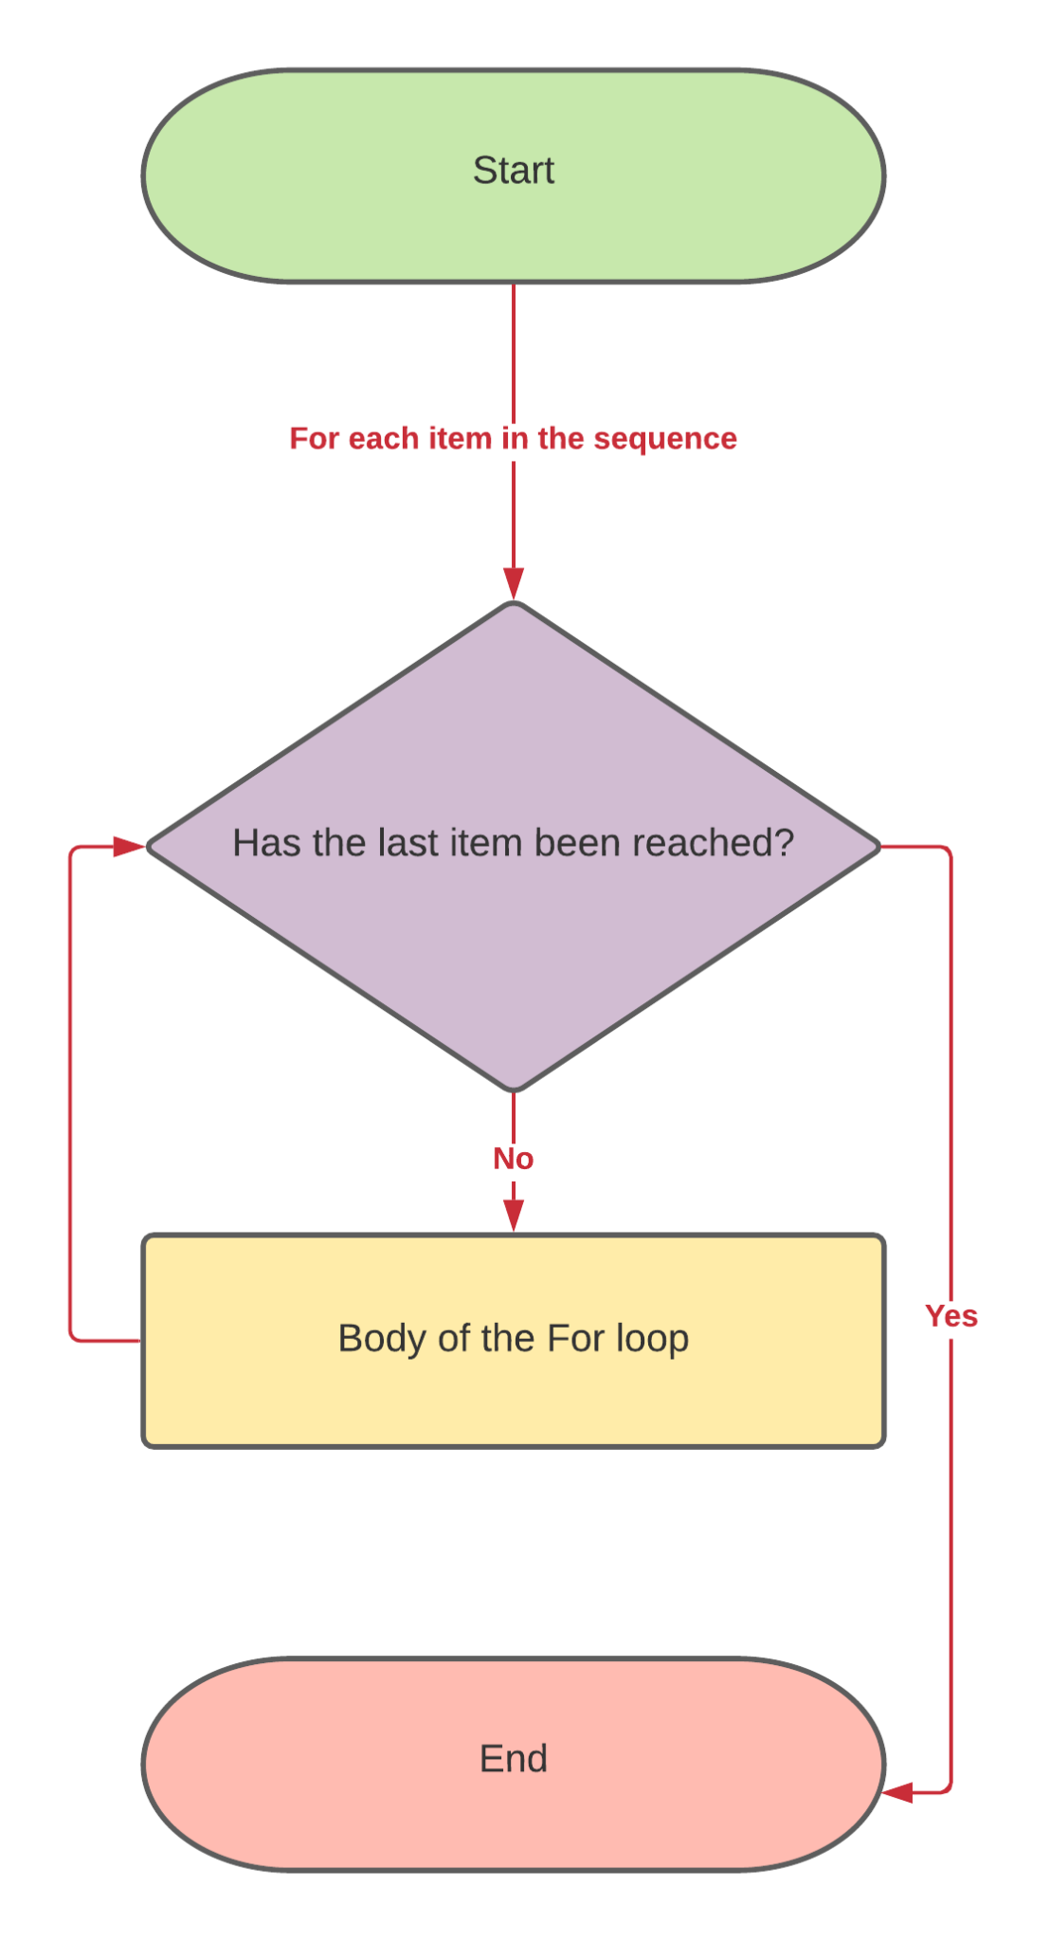
For Loops
For loops are a type of loop that runs until we reach the last item in a sequence, such as a list or string
This process of iterating over a sequence is called a traversal
Because loops and tuples have defined start and end points, for loops are useful when you know how many times you want to iterate over something
If you want to loop over something, say 9 times, you can use the range() function with a for loop
The range takes in a sequence of numbers separated by a comma (and an optional step size)
It is exclusive of the last number
range(0,10) - Generate numbers 1-9
range(0,,10,2) - Print even numbers 0-9

Slide 7
While Loops
The while loop is another type of loop, but it differs from a for loop in that it checks for a condition is true before each run
While loops keep on checking if that condition is True, and when that condition isn’t true, it stops looping
You can see this can be dangerous if our condition is never false
You can potentially have a loop that just runs forever, and it can maybe even crash your computer
In our IDE it isn’t too much of a deal because we don’t have a lot of resources or doing too labor intensive operations
Remember to be careful still!

Slide 8
Ugh, the boring stuff. We’ll make it quick!
Python
Loop Syntax

Slide 9
Loop Syntax in Python
for (some condition):
# Do something
To make a for loop, look at the example on the right
We can see that indentation is important once again in separating the start of our loop and body
The big word here is for, which tells Python that we are making a for loop
The while loop syntax is on the right
Very similar to the for loop, but just using the while keyword
An important statement in Python is the break statement, which terminates the loop
This can be helpful if you want to further check the condition using an if statement before the loop proceeds
while (some condition):
if condition:
break #Takes out of loop
#Do something

Slide 10
Loopity da loop ba doop (Running out of things to put here)
Practice
With Loops

Slide 11
Problem Set One
Exercise One:
Create a loop that prints our every single letter in a string that a user passes
Think about which loop would be best here and use it!
Exercise Two:
Print out all of the squares from 1-15 (inclusive of 15)
Exercise Three:
Print out whether a number is even or odd from 1-50 (exclusive of 50)
For 11, 8, 20 and 21, print out that these are lucky numbers!
Exercise Four:
Add up every even number from 10-20 (inclusive of 20) and print it out!

Slide 12
PRactice next week, and then project!
Thank you!
That is all we have for today!

